Slide 1
Elementary Writing 3-5 Kris Barnes Curriculum Specialist ELA October 24, 2015

Slide 2
Higher Moral Purpose

Slide 3
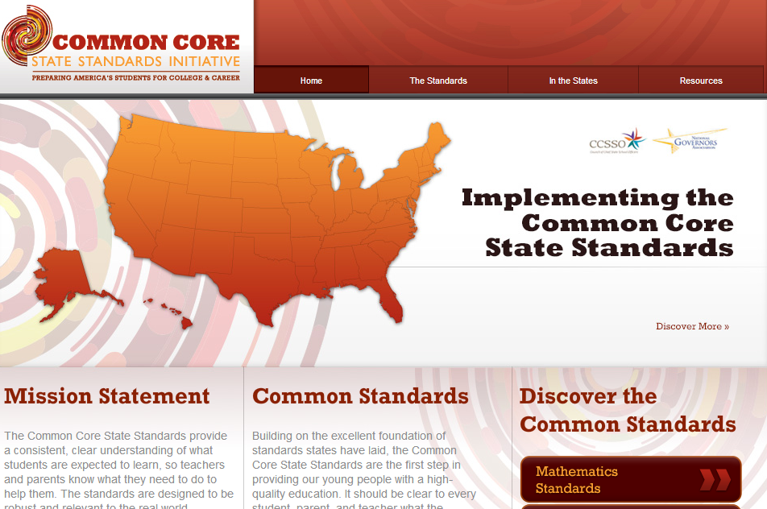
Writing
Reading

Slide 4
Outcomes
Examine the writers workshop model
Identify the writing genres and purposes of each
Review the publishing cycle
Develop strategies to support students in writing

Slide 5
Every Child a Writer
Every child needs between forty-five and sixty minutes for writing and writing instruction at least four times a week.
Giving young children the opportunities to write something for someone makes it likely that writing will engage children and that they will feel as if the work they are doing is real, credible, and substantial.

Slide 6
Writing makes us smarter.
“There are no silver bullets in education, but writing – particularly nonfiction writing – is about as close as you can get to a single strategy that has significant and positive effects in nearly every other area of the curriculum. “
--Douglas Reeves, Leadership and Learning Center
Let’s See What our Kids Are Writing…….

Slide 7
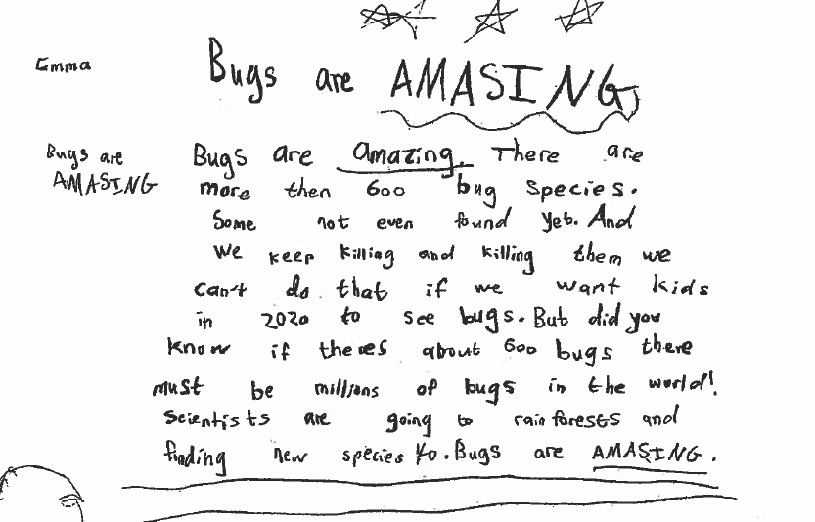

Slide 8
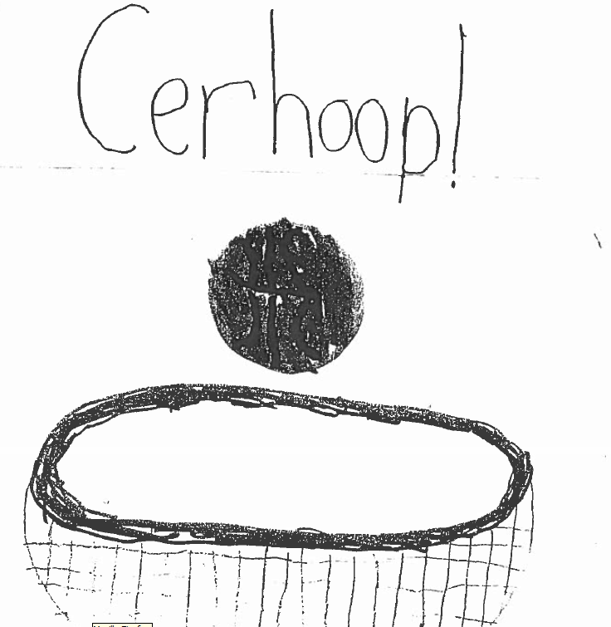

Slide 9
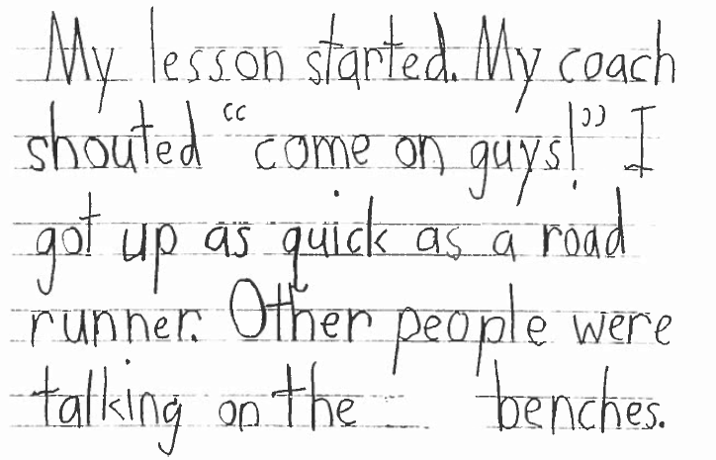

Slide 10
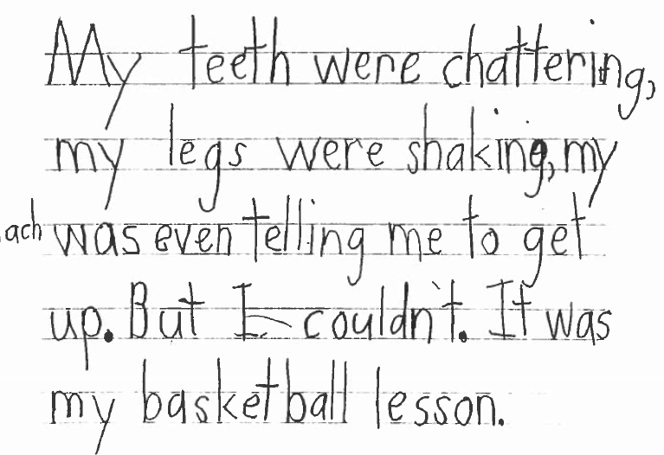

Slide 11
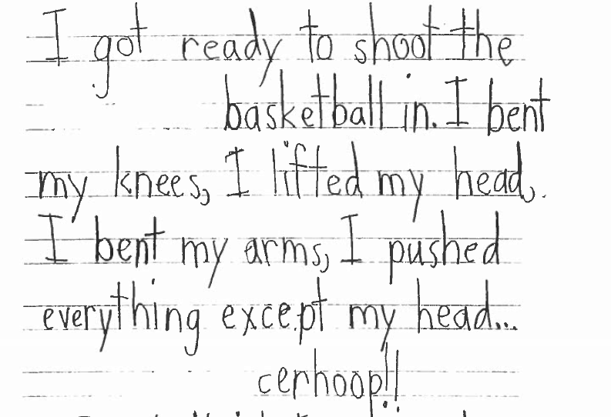

Slide 12
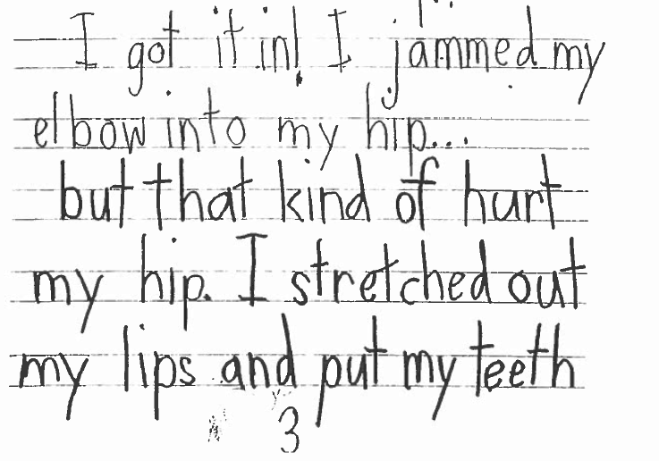

Slide 13
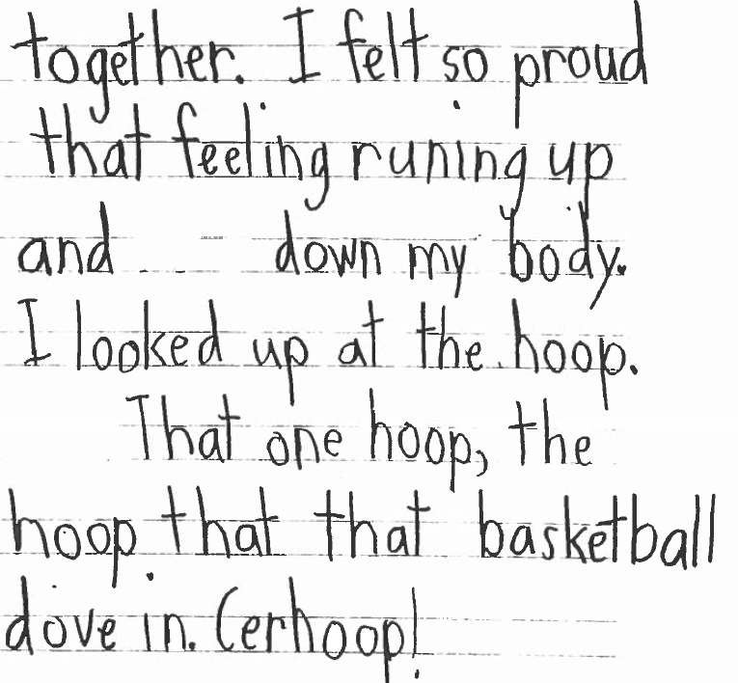

Slide 14
Information | Narrative | Opinion Argument
Purpose: explain/teach | Purpose: tell a story | Purpose: convincingly present a point of view
Structure: Topics & Subtopics | Structure: Beginning, Middle, and End | Structure: Claim & Support

Slide 15
The Writers Workshop
Many Seattle Public Schools are using teaching model of Writers Workshop for writing instruction.
Let’s take a look:
The Writing Workshop

Slide 16
Cycle of a Workshop
Students gather to close lesson 5 min
Mini Lesson- 10 min
Students write for up to 45 minutes

Slide 18
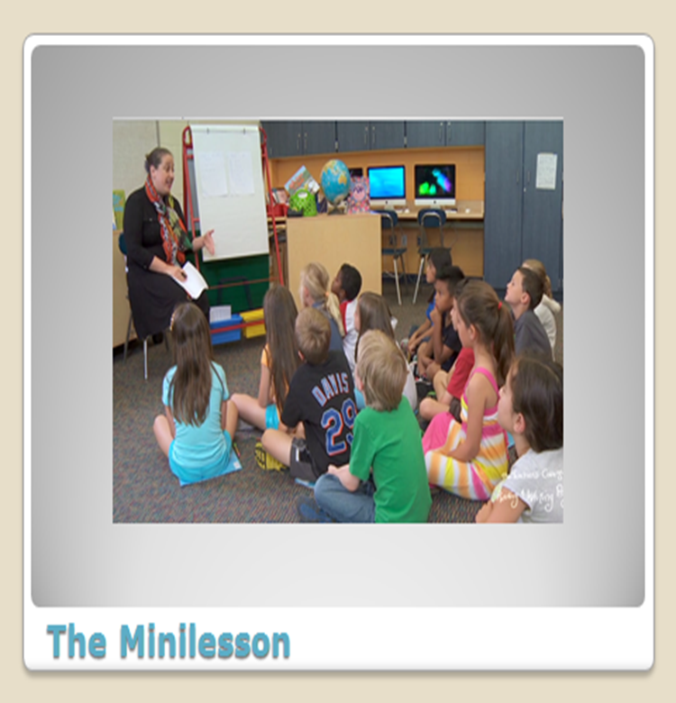

Slide 19
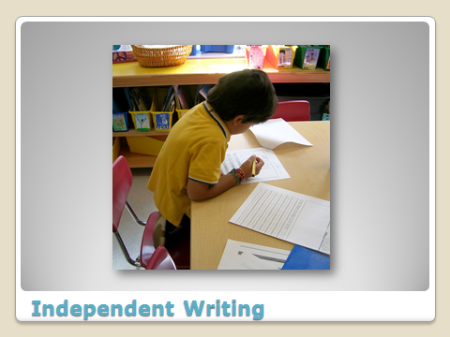

Slide 22
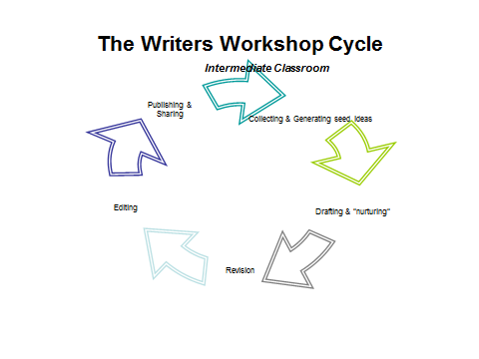
Supporting Students
Where students are in the writing cycle will guide the support that you give students.

Slide 23
The Writers Workshop Cycle
Intermediate Classroom
Generating
Publishing &
Sharing
Collecting & Generating seed ideas
Editing
Drafting & “nurturing”
Revision

Slide 24
Let’s Try It
Today I want to teach you a strategy you can use when you are having trouble coming up with an idea for a story.....
Narrative Generating Strategy

Slide 25
1. Generating Idea for Narrative Writing
Think of a person who matters to you, list small moments, choose one, then write the story
Watch me as I try this……
Notes:
Model- have folks write

Slide 26
2. Generating Idea for Informational Writing
Make a list of Every’s
Every day I…… drive to work, read the paper
Every weekend I……. do laundry, go to yoga
Every summer I…… drive to the cabin, go waterskiing
Oral Rehearsal, chose one- make a list on your hand about the parts- start to get to the table of contents….
Informational Writing
Notes:
Model- have folks write

Slide 27
2. Generating Idea for Informational Writing
Make a list of Every’s
Every day I…… drive to work, read the paper
Every weekend I……. do laundry, go to yoga
Every summer I…… drive to the cabin, go waterskiing
Oral Rehearsal, chose one- make a list on your hand about the parts- start to get to the table of contents….
Informational Writing
Notes:
Model- have folks write

Slide 28
3. Generating Opinion Writing
List some things that you would change if you could, chose one, write about it……
Seattle should have recycling every week
Everyone should have a 4 day work week

Slide 29
The Writers Workshop Cycle
Intermediate Classroom
Generating Strategies
Publishing &
Sharing
Collecting & Generating seed ideas
Editing
Drafting & “nurturing”
Revision
Read it back to me

Slide 30
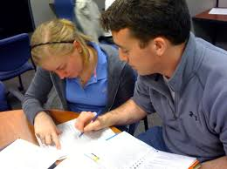
2. RE-CARR (read it back)
Read-Have student read a small part back to you
Compliment them on their work
Ask- “What are you trying to do to make your writing better?”
Revise-add or delete
Read it again
Notes:
Go back to your narrative piece of writing- try this with a partner.

Slide 31
The Writers Workshop Cycle
Intermediate Classroom
Generating strategies
Publishing &
Sharing
Collecting & Generating seed ideas
Editing
Drafting & “nurturing”
Revision
IADD
Read it back to me

Slide 32
IADD
I- Inner thinking: Explain what the character is thinking or feeling- “This is going to be fun,” I thought to myself.
A- Action: I scuttled around the corner and hid, my heart pounding wildly.
Dialogue: “Listen up,” I demanded.
Description: The sky was dark and stormy with fat dense clouds looming
Notes:
Try this with a partner- must be in narrative

Slide 33
The Writers Workshop Cycle
Intermediate Classroom
Generating strategies
Read and Review
Publishing &
Sharing
Collecting & Generating seed ideas
Editing
Drafting & “nurturing”
Revision
IADD
Read it back to me

Slide 34
Editing
Spelling- ask the student to go through and circle the words that they believe might be misspelled
Organization- (if possible) make a copy of the written draft- have the student cut the paper up and re-organize. Tape back together after re- org.
Grammar- support sentence punctuation, quotations, and other grammar support through a re-reading and side by side support. Use books to show examples e.g. periods, paragraphs etc.
Checklist- Use a check list if student has one for support.

Slide 35
Coaching Young Writers
A coach is someone who can give correction without causing resentment.
John Wooden

Slide 36
Compliments go a long way- Find and name what students are doing well
One of the strongest things I notice about your writing is….
One thing I am learning from your writing is…
I can see that you as a writer really care about…
I really like this part because…..
This part…. It really works because….
This part makes me think about…..
Notes:
Try a complement stem with a partner

Slide 37
Exemplars-What should grade level writing look like?

Slide 38
Let’s look at the writing progressions across grades 3-5
Narrative- The Scary Dog
Informational- Bulldogs
Opinion- Football

Slide 39
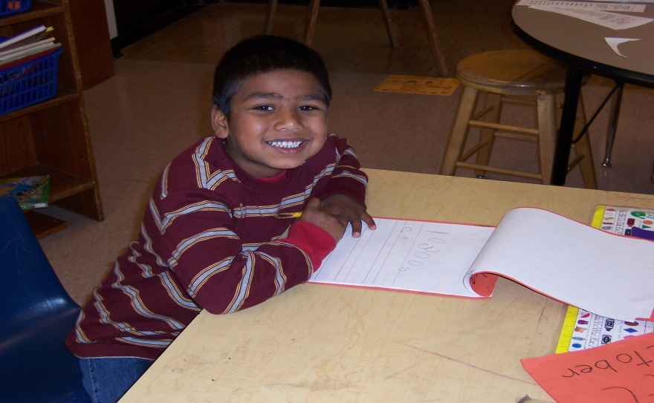
Writers Workshop
CHILDREN’S SUCCESS IN MANY DISCIPLINES IS UTTERLY RELIANT ON THEIR ABILITIES TO WRITE: CHILDREN DESERVE WRITING TO BE A SUBJECT THAT IS TAUGHT AND STUDIED JUST LIKE READING OR MATH
- Lucy Calkins

Slide 40
Your life is worth writing about…

Slide 41
Thank you!
Thank you for supporting all students!

